Slide 1
Cup-O Java
Aaron Young
Trae Rawls
Bryce Fenske

Slide 2
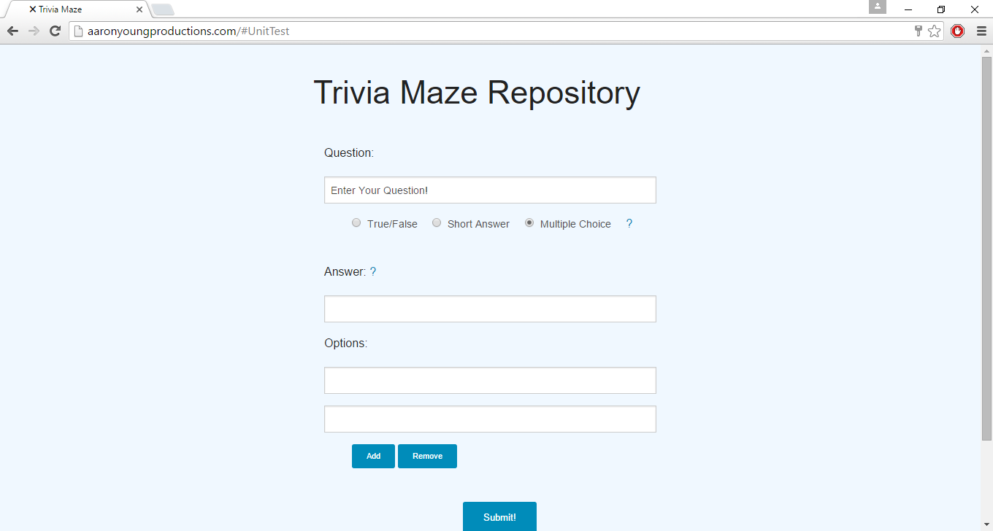
Web Portal – Admin Tools

Slide 4
